Slide 1
Introducing C’s Program Control Statements
Thanks to
Nakib Hayat Chowdhury

Slide 2
Program Control Statements
Control statements control the flow of execution in a program or function.
There are three kinds of execution flow:
Sequence:
the execution of the program is sequential.
Selection:
A control structure which chooses alternative to execute.
Repetition:
A control structure which repeats a group of statements.

Slide 3
Decision Making Statement
if statement
switch statement
Conditional operator statement
goto statement
They are also known as control statements.

Slide 4
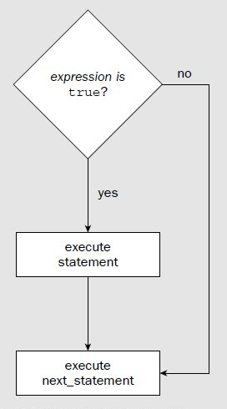
BECOME FAMILIAR WITH THE if
In its simplest form, the if statement allows our program to conditionally execute a statement.
Its operation is governed by the outcome of a conditional test evaluates to either true or false.

Slide 5
Different forms of if statement
Simple if statement
if....else statement
Nested if......else statement
else if ladder

Slide 6
If….
Simplest form of if for single statement
For multiple statements
if(expression)
statement;
if(expression)
{
statement 1;
statement 2;
……
statement n;
}

Slide 7
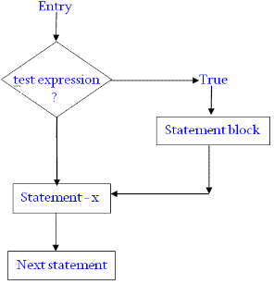
If….
The expression may be any valid C expression.
If the expression evaluated as true, the statement will be executed.
If it does not - the statement is bypassed and the line of code following the if is executed.

Slide 8
Old Problem!
Draw the flowchart of a program that reads two numbers and print “First” if first number is greater than second.
The program
Home Task
Write a program that will reads a number from terminal and determine whether this number is ‘odd’ or ‘even’ and print the message- NUMBER IS EVEN or NUMBER IS ODD
Write a program to determine whether a given number is divisible by 7 and 3 or not.

Slide 9
if....
In C, an expression is true if it evaluates to any nonzero value.
If it evaluate to zero, it is false.

Slide 10
What will happen?
int a=10, b=20;
if(a < b)
printf(“This line will print.”);
Output
This line will print.

Slide 11
What will happen?
int a=10, b=20;
if( a > b)
printf(“This line will print.”);
Output
Nothing!

Slide 12
What will happen?
int a=10, b=20;
if( 0 )
printf(“This line will print.”);
int a=10, b=20;
if( 10 )
printf(“This line will print.”);
Output
Output
This line will print.
Nothing!

Slide 13
What will happen?
int a=10, b=20;
printf(“%d”, a<=b);
Output
1

Slide 14
ADD THE else!
We can add else statement to the if.
The if…else statement is an extension of the simple if statement.
if(test expression)
{
True-block statement(s)
}
else
{
False-block statement(s)
}
Statement x

Slide 15
ADD THE else!
Which number is greater?

Slide 16
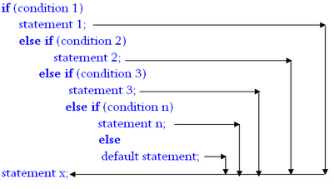
else if Ladder!
Which number is greater?

Slide 17
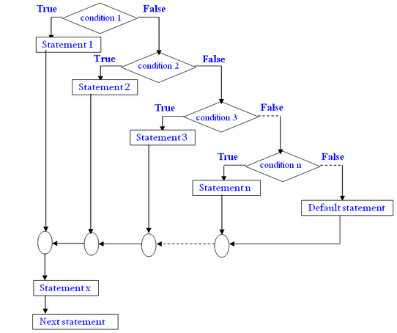
if…else Ladder!
Notes:
Grade Example Page-124 (ANSI C)

Slide 18
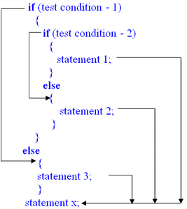
Nested if…else

Slide 19
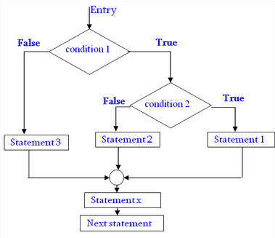
Nested if…else

Slide 20
Nested if…else
Problem!
A commercial bank has introduced an incentive policy of giving bonus to all its deposit holders. The policy is as follows: A bonus of 2 per cent of the balance held on 31st December is given to every one, inspective of their balance, and 5 per cent is given to female account holders if their balance is more than Tk. 50,000.

Slide 21
Nested if…else
Problem!
A commercial bank has introduced an incentive policy of giving bonus to all its deposit holders. The policy is as follows: A bonus of 2 per cent of the balance held on 31st December is given to every one, inspective of their balance, and 5 per cent is given to female account holders if their balance is more than Tk. 50,000.

Slide 22
Conditional Operators
exp1 ? exp2 : exp3

Slide 23
The Conditional Operator
(? : )
the conditional operator
A conditional expression is written in the form
expression 1 ? expression 2 : expression 3
True or False?
True
False

Slide 24
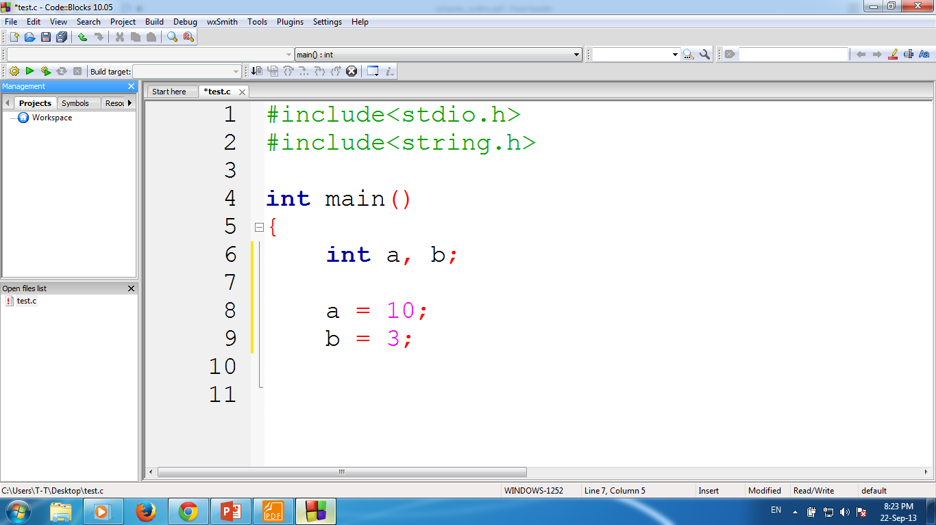
The Conditional Operator
(a + b) >= 13 ? a = 100 : a = 1000
True or False?
True

Slide 25
The Conditional Operator
i = (a+b)<13 ? 100 : 1000
True or False?
False

Slide 26
SELECT ALTERNATIVE WITH THE switch STATEMENT
If is good for choosing between two alternatives
When several alternatives are needed we should use switch statement.
switch is C’s multiple selection statement.
Use to select one of several alternative paths in program execution

Slide 27
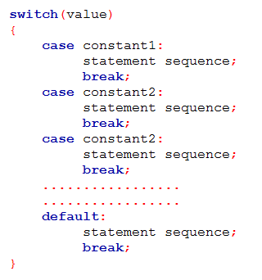
How it works?
A value is successively tested against a list of integer or character constants.
When the match is found, the statement sequence associated with that match is executed.
Statement sequence are not blocks, not use curly braces

Slide 28
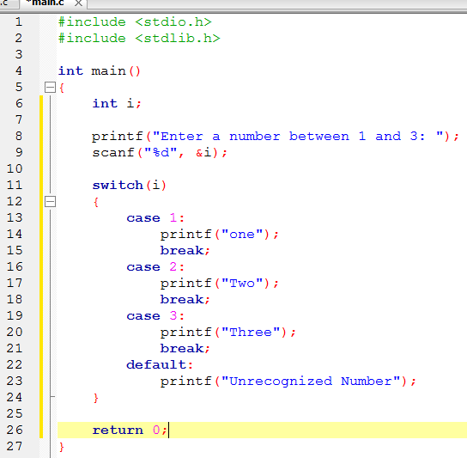
Example - switch
Notes:
Grade System Program: A->Excellent! B->Good C->OK D->You just Pass the exam F->Better try next time

Slide 29
if vs switch
switch can only test for equality, where the if conditional expression can be of any type
switch will work with only int or char types. We can’t use float or others.

Slide 30
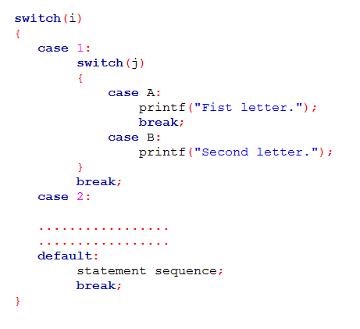
Nested switch!

